Slide 1

Cloud Learning Journey #13 Kickoff February 13, 2018

Slide 2

Agenda
Introduction
Cloud Program Overview
Timeline
Resources
Cloud Boot Camp
In-Practice Project
Next Steps
Q&A

Slide 3
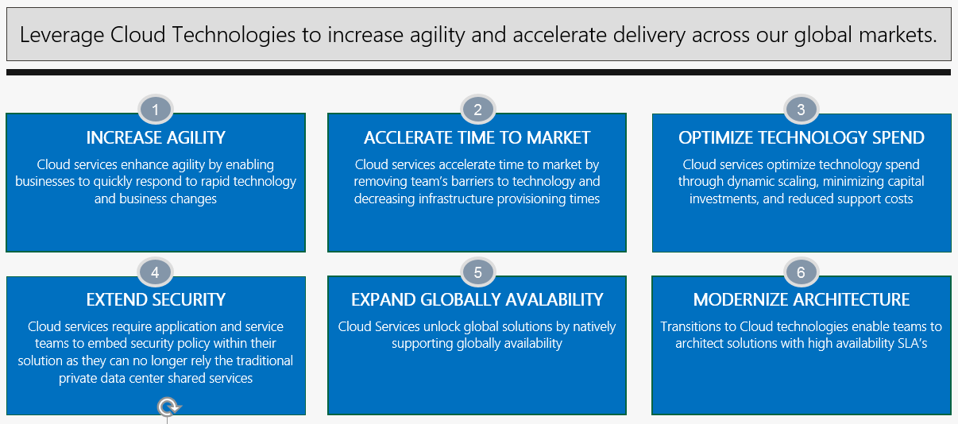
Vision – Why Cloud?

Slide 4

A Transformation in the Making
CLJ #13 is the 12th full Cloud Learning Journey since Oct 2016.
330 partners have completed Cloud training in 2017 and at least 300 more will be trained in FY18. (185 YTD)
Most partners start with little to no experience with Cloud and are able to demonstrate their knowledge and contribution to the Cloud ecosystem by the end of their journey.
Partners who start with some Cloud experience gain up-to-date knowledge, new insights and a chance to mentor others.
New friends at work – partners collaborating with new people, tackling new challenges.

Slide 5
CLJ #13 Cohort
Chris Fallon
Saratha Prabu
Jeff Wiles
Philip Black
Tal Saraf
Aaron Hudson
Tigist Mammo
Quy Le
Kurt Smith
Akanksha Rakesh
Cara Anderson
Mat Cles
Randy Carlson
Ivan Tichenor
Ihar Simanovich
Chris Launey
Hema Kannan
Janet Landers
Brian Knowles
TBD, coach CLJ #13
Frank Fuoco, Talent Lab/Cloud
Scott Bockheim,
director Cloud Services

Slide 6
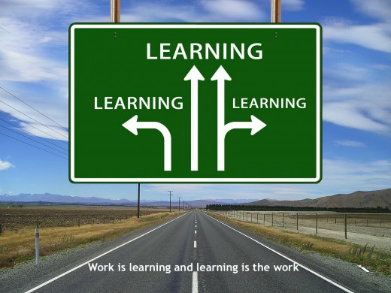
Why a “learning journey”?
Elements:
Formal instruction
Weekly study halls & facilitated discussion
Reference site for links and documents
Coach and Talent Lab support
Curated Safari Books Online and Pluralsight content
In-practice project
Community of co-learners

Slide 7










Timeline
Cloud Roadmap
CLJ #13 Cloud Learning Journey
FY18
Q1 Q2 Q3
Cloud Pgm
2 weeks
1 week
7 - 8 weeks
Cloud Pgm
Cloud Pgm
Team Project
Choose Cohort Members
Infra
IPS
Develop Intelligence
coach
Cohort
Graduation
April 26
Student
Pre-work
Cloud Boot Camp
Feb 20-22
Cloud Intro
Azure Intro
Cloud tools
Starbucks approach
Security guidelines
Infrastructure guidelines
ST Role Impacts
Weekly Study Halls via Virtual Meeting
Cloud LJ
Kickoff Meeting
Choose Coach/SME
Feb 13
CredoSec
Microsoft
Team
presentations
Cloud Security
Mar 14-16
Azure
Deep-dive
Mar 26-29
Cloud Pgm
12 weeks
Feb 19: Cloud Essentials for Managers/PMs/Analysts
Cohort
Graduation

Slide 8
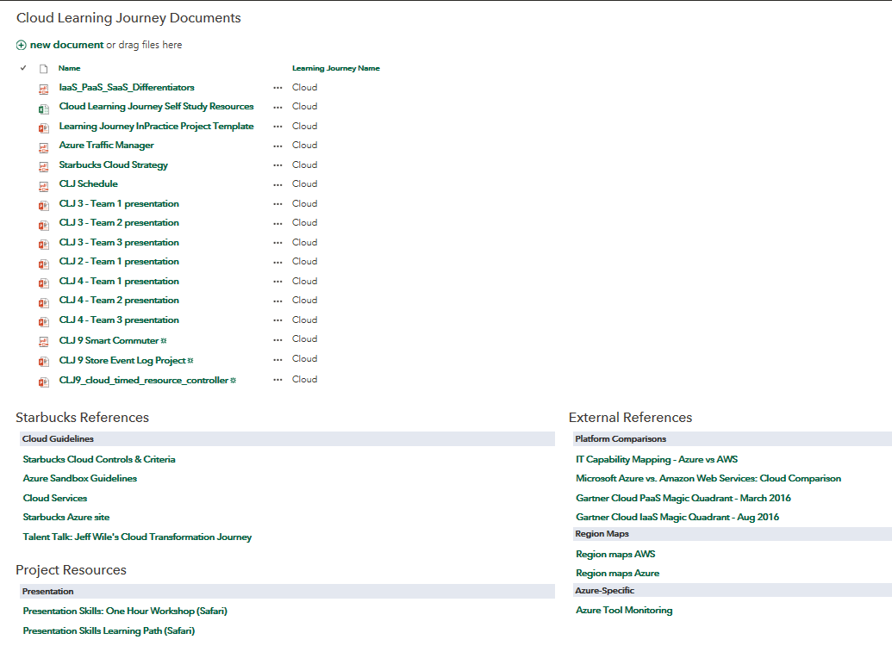
Resource Site
Cloud Learning Journey Resources SharePoint Site

Slide 9
Learning Resources – Self Study
Resource Name | Category | Level | Site | Medium | Duration (hours) | CBC Pre-Req
Cloud Computing: The Big Picture | Cloud Intro | Beginner | Pluralsight | Course | 1:13 | Yes
Microsoft Azure: The Big Picture | Azure Intro | Beginner | Pluralsight | Course | 1:50 | Yes
Intro to Cloud Computing with AWS | AWS Intro | Beginner | Safari | Video | 5:10
Cloud Concepts, Technology & Architecture | Cloud Architecture | Intermediate | Safari | Book
Implementing Cloud Services for Azure Infrastructure | Azure Architecture | Intermediate | Pluralsight | Course | 2:52
Architecting the Cloud: Design Decisions | Cloud Design | Intermediate | Safari | Book
Getting Started with Jenkins | Jenkins | Beginner | Pluralsight | Course | 2:38
Getting Started with Docker | Docker | Beginner | Pluralsight | Course | 2:12
Introduction to Apache Kafka | Kafka | Intermediate | Safari | Video | 2:55
Apache Spark Fundamentals | Spark | Intermediate | Pluralsight | Course | 4:27
Cassandra for Developers | Cassandra | Intermediate | Pluralsight | Course | 3:27
Azure Microsoft Virtual Academy | Azure | all levels | Microsoft Virtual Academy | learning plans
Azure Video Center | Azure | all levels | microsoft.com | videos
AWS training | AWS | all levels | AWS training & certification | classes, labs

Slide 10
Cloud Boot Camp
 | Day 1 | Day 2 | Day 3
BOOT CAMP TOPICS | Cloud @ Starbucks Intro Cloud Impacts Cloud Technical Overview Azure Overview Azure App Services | Architecting for the Cloud Designing for the Cloud Starbucks Guidelines (Infrastructure & Security) | Cloud Tools Overview Docker Intro
RESOURCES | Cloud Computing: The Big Picture (Pluralsight 1:13) ** Microsoft Azure: The Big Picture (Pluralsight 1:50) ** Intro to Cloud Computing with AWS (video-Safari) | Cloud Concepts, Technology & Architecture (book-Safari) Implementing Cloud Services for Azure Infrastructure (Pluralsight 2:52) Architecting the Cloud: Design Decisions (book-Safari) | Getting Started with Jenkins (Pluralsight 2:38) Getting Started with Docker (Pluralsight 2:12)
** Recommended pre-reads for Boot Camp

Slide 11
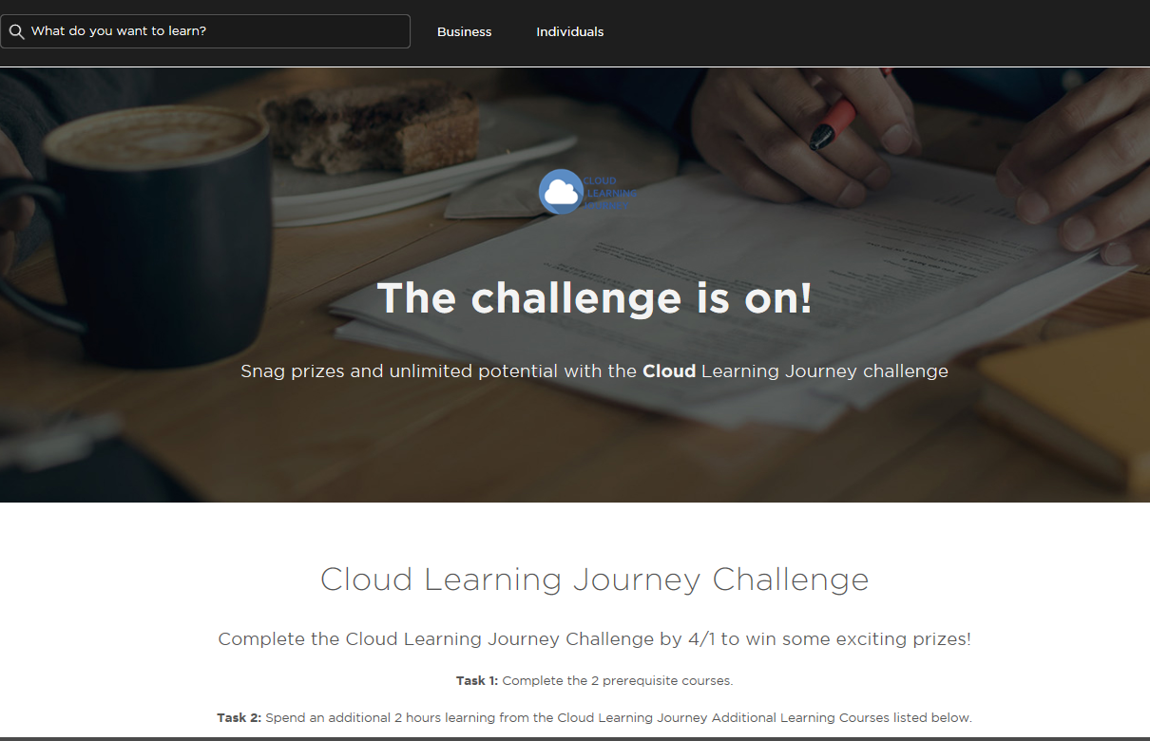
PluralSight

Slide 12

“In Practice” Projects
WHAT & WHY: As partners progress through the learning journey, they identify a piece of work that gives them a chance to practice and demonstrate knowledge and competence.
WHO & HOW: Cohort members split into small groups to work on a project.
WHEN & WHERE: Projects, key learning and insights are presented to peers, current and future cohorts and your leadership on April 26th

Slide 13
Next Steps
Confirm Safari and Pluralsight access
Accept CLJ #13 meeting invites
Do Cloud Boot Camp pre-reads
Work with your manager(s) to protect your time for learning and practice
Plan to share knowledge across your team

Slide 14
Questions?
Notes:
TEXT SLIDE, LIGHT BACKGROUND: Options of plain background (not shown) or 3 patterns: “Costa Rica,” “Colombia,” or “Rwanda”
FONT: Arial is the designated font. Corbel may be substituted if available. Use all caps for headlines and subheads.
TEXT FORMATTING: Title and subtitle text may overlap with the pattern.
IMAGES: Photos should be placed in the lower section of the slide – either a single image or a collage of images cropped to the same height, top-aligned and bleeding off the bottom, left and right sides.
PHOTO FORMATTING:
To adjust a distorted photo:
Reset the image: Select the image, then in the Picture Tools tab, choose Reset Picture and Size.
Change the size of a photo:
Select the image. To resize, use the round handles at the corners to resize, holding the shift key to keep the photo from distorting. Any part of the photo that goes off the edge of the slide will not be seen in slide show mode or when printed.
Using the Crop Tool:
Select the image to activate the Picture Tools tab, and click the Crop Tool button. Use the square corners to adjust the crop of the image. To move the image around within the crop corners, click on the image and drag. Once you are satisfied with the crop, you may need to resize the image.

